Slide 1

Puzzle-3

Slide 3
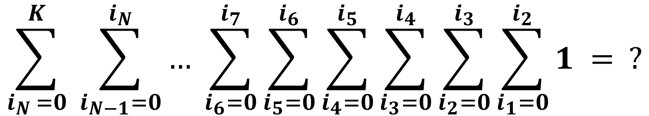
Trouble With Summations!!!
$$\sum_{i_{N }=0}^{K}{ \sum_{i_{N−1}=0}^{i_{N}}{… \sum_{i_{6}=0}^{i_{7}}{\sum_{i_{5}=0}^{i_{6}}{\sum_{i_{4}=0}^{i_{5}}{\sum_{i_{3}=0}^{i_{4}}{\sum_{i_{2}=0}^{i_{3}}{\sum_{i_{1}=0}^{i_{2}}{1}}}}}}}} = ?$$

Slide 4
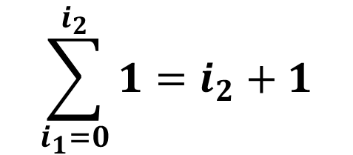
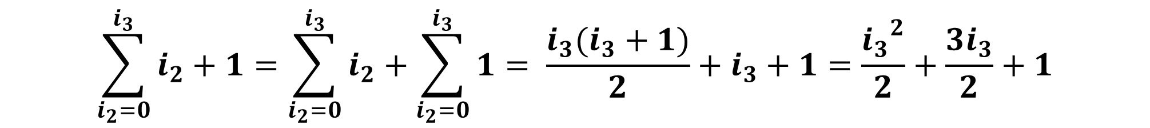
First things that come in mind…
$$\sum_{i_{1}=0}^{i_{2}}{1}=i_{2}+1$$
$$\sum_{i_{2}=0}^{i_{3}}{i_{2}+1}=\sum_{i_{2}=0}^{i_{3}}{i_{2}}+\sum_{i_{2}=0}^{i_{3}}{1}= \frac{i_{3}(i_{3}+1)}{2}+i_{3}+1=\frac{{i_{3}}^{2}}{2}+\frac{3i_{3}}{2}+1$$

Slide 5

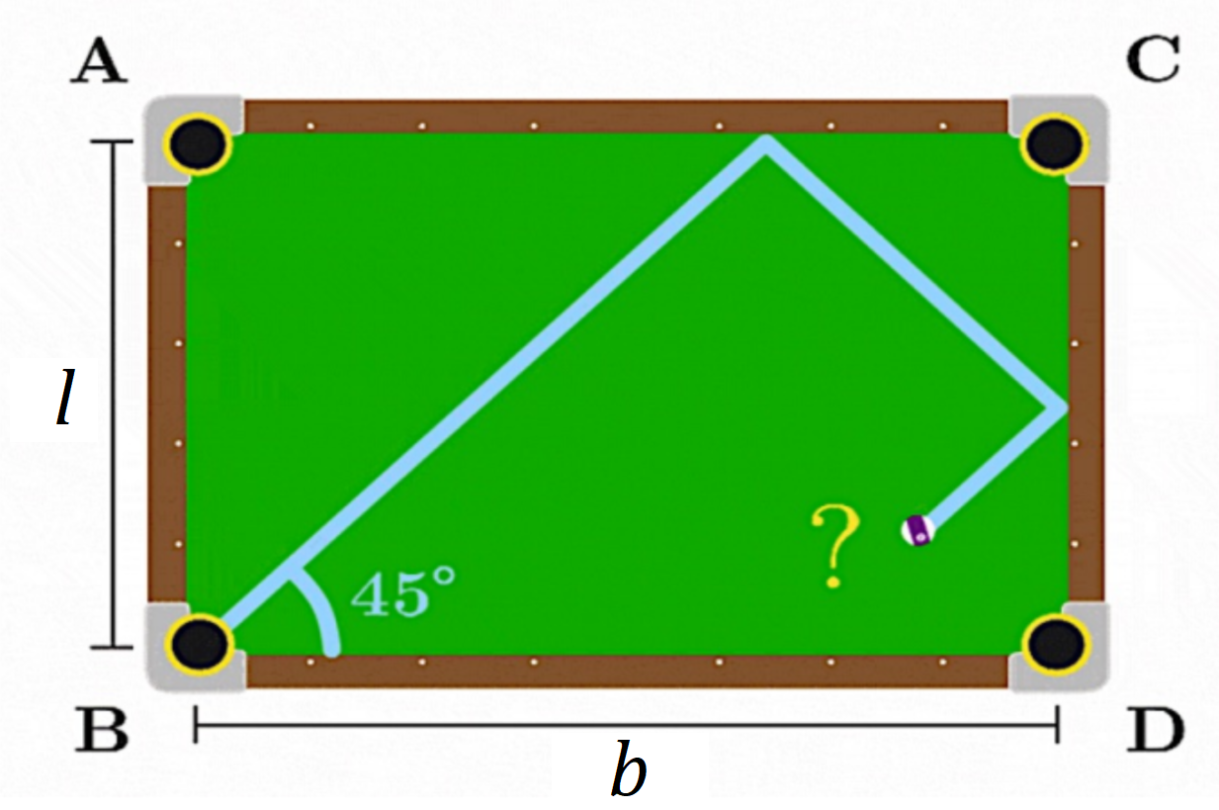
Weekend Puzzle – 2
Which pocket will the ball end up in?
Assume that the ball is shot at a 45-degree angle directly from the corner of the table (as shown below) and that it will only land in a pocket if the center of the ball meets the corner of the pocket exactly. Also, assume the surface has no friction so that the ball will keep bouncing as long as necessary.
Source: Problem 0B from Brilliant.org’s 100-day Summer Challenge 2017

Slide 6
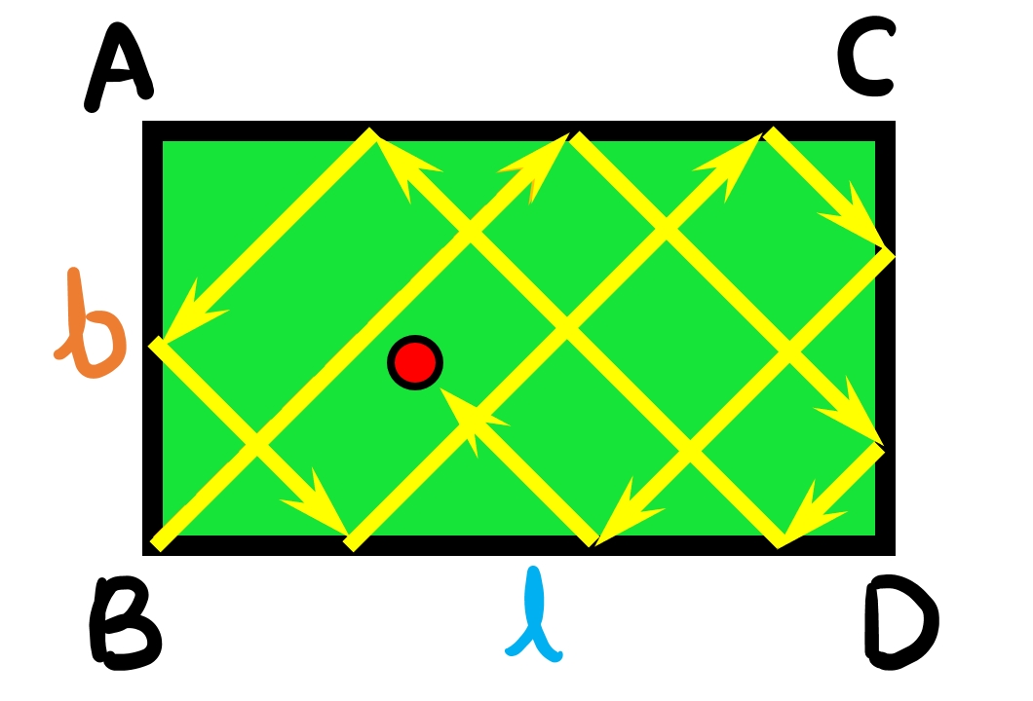

Slide 7
It’s very hard to understand this trajectory :(

Slide 8
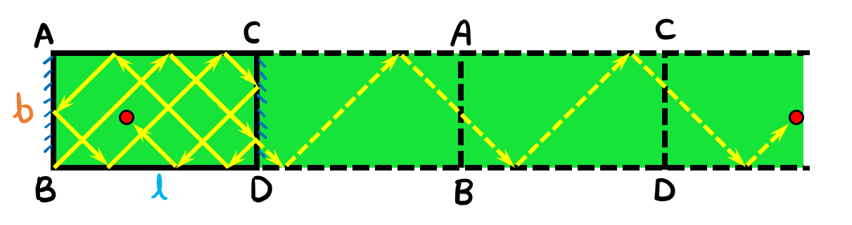

Slide 9
Reflections make things much simpler :)

Slide 10
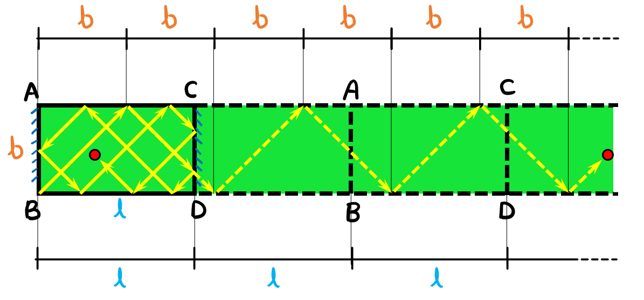

Slide 11
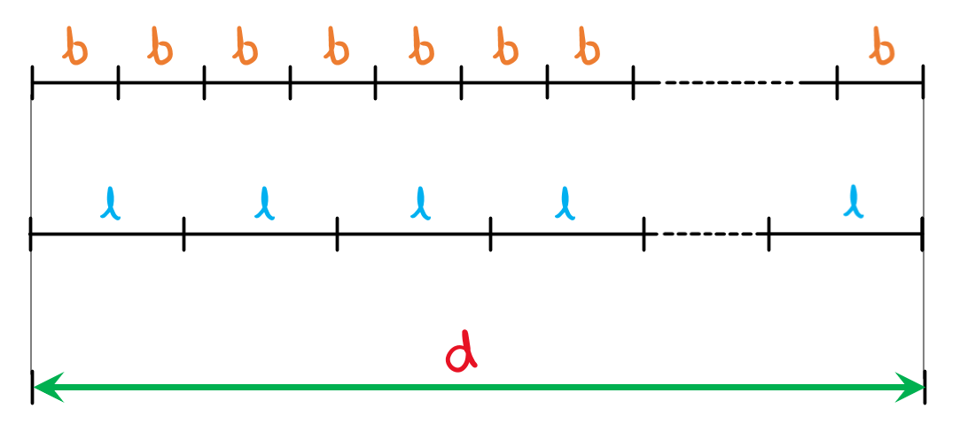

Slide 13



1
$$d=xb$$
$$d=yl$$
$$s.t. x,y ∈ ℕ$$

Slide 14
1
$$d=xb$$
$$d=yl$$
$$s.t. x,y ∈ ℕ$$
2
$$d is smallest such number \left(as described in 1\right), because the ball$$
$$won^{′}t continue its trajectory once it has fallen into a pocket.$$

Slide 15


1
$$d=xb$$
$$d=yl$$
$$s.t. x,y ∈ ℕ$$
2
$$d is smallest such number \left(as described in 1\right), because the ball$$
$$won^{′}t continue its trajectory once it has fallen into a pocket.$$
$$∴$$

Slide 16




$$d=xb$$
$$d=yl$$
$$s.t. x,y ∈ ℕ$$
$$d=lcm(b,l)$$

Slide 17
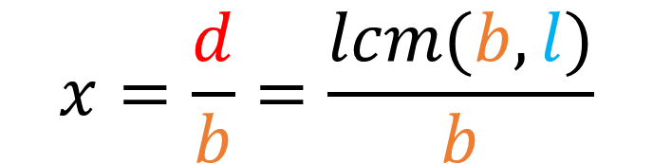
$$d=xb$$
$$d=yl$$
$$s.t. x,y ∈ ℕ$$
$$d=lcm(b,l)$$
$$x=\frac{d}{b}=\frac{lcm(b,l)}{b}$$

Slide 18
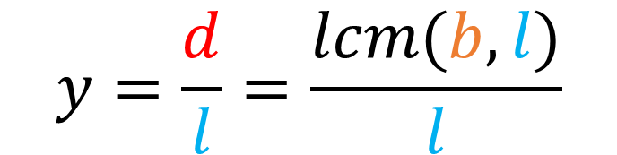
$$d=xb$$
$$d=yl$$
$$s.t. x,y ∈ ℕ$$
$$d=lcm(b,l)$$
$$x=\frac{d}{b}=\frac{lcm(b,l)}{b}$$
$$y=\frac{d}{l}=\frac{lcm(b,l)}{l}$$

Slide 19
$$d=xb$$
$$d=yl$$
$$s.t. x,y ∈ ℕ$$
$$d=lcm(b,l)$$

Slide 20

$$d=xb$$
$$d=yl$$
$$s.t. x,y ∈ ℕ$$
$$d=lcm(b,l)$$
$$xb=yl$$

Slide 21
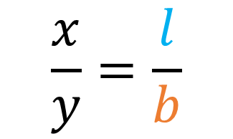

$$d=xb$$
$$d=yl$$
$$s.t. x,y ∈ ℕ$$
$$d=lcm(b,l)$$
$$xb=yl$$
$$\frac{x}{y}=\frac{l}{b}$$

Slide 22
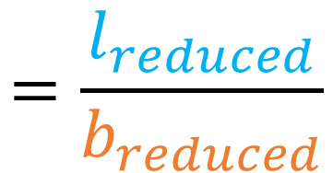
$$d=xb$$
$$d=yl$$
$$s.t. x,y ∈ ℕ$$
$$d=lcm(b,l)$$
$$xb=yl$$
$$\frac{x}{y}=\frac{l}{b}$$
$$=\frac{l_{reduced}}{b_{reduced}}$$

Slide 23


$$d=xb$$
$$d=yl$$
$$s.t. x,y ∈ ℕ$$
$$d=lcm(b,l)$$
$$xb=yl$$
$$\frac{x}{y}=\frac{l}{b}$$
$$=\frac{l_{reduced}}{b_{reduced}}$$
$$x=l_{reduced}$$
$$y=b_{reduced}$$

Slide 24
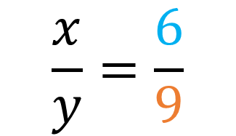
$$d=xb$$
$$d=yl$$
$$s.t. x,y ∈ ℕ$$
$$d=lcm(b,l)$$
$$xb=yl$$
$$\frac{x}{y}=\frac{6}{9}$$
$$=\frac{l_{reduced}}{b_{reduced}}$$
$$x=l_{reduced}$$
$$y=b_{reduced}$$

Slide 25
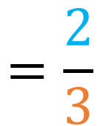
$$d=xb$$
$$d=yl$$
$$s.t. x,y ∈ ℕ$$
$$d=lcm(b,l)$$
$$xb=yl$$
$$\frac{x}{y}=\frac{6}{9}$$
$$=\frac{2}{3}$$
$$x=l_{reduced}$$
$$y=b_{reduced}$$

Slide 26


$$d=xb$$
$$d=yl$$
$$s.t. x,y ∈ ℕ$$
$$d=lcm(b,l)$$
$$xb=yl$$
$$\frac{x}{y}=\frac{6}{9}$$
$$=\frac{2}{3}$$
$$x=2$$
$$y=3$$

Slide 27
$$d=xb$$
$$d=yl$$
$$s.t. x,y ∈ ℕ$$
$$d=lcm(b,l)$$
$$xb=yl$$
$$\frac{x}{y}=\frac{l}{b}$$
$$=\frac{l_{reduced}}{b_{reduced}}$$
$$x=l_{reduced}$$
$$y=b_{reduced}$$

Slide 28
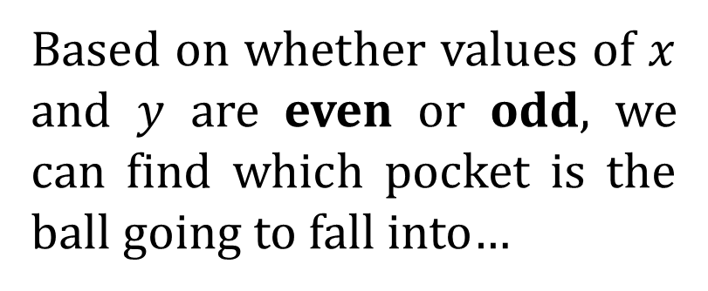
Based on whether values of $x$ and $y$ are even or odd, we can find which pocket is the ball going to fall into…

Slide 29


Based on whether values of $x$ and $y$ are even or odd, we can find which pocket is the ball going to fall into…
If $x$ is odd, the ball will fall either in pocket A or pocket C.

Slide 30
Based on whether values of $x$ and $y$ are even or odd, we can find which pocket is the ball going to fall into…
If $y$ is odd, the ball will fall either in pocket C or pocket D.

Slide 31
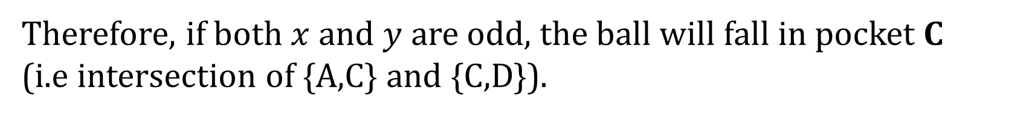
Based on whether values of $x$ and $y$ are even or odd, we can find which pocket is the ball going to fall into…
If $x$ is odd, the ball will fall either in pocket A or pocket C.
If $y$ is odd, the ball will fall either in pocket C or pocket D.
Therefore, if both $x$ and $y$ are odd, the ball will fall in pocket C
(i.e intersection of {A,C} and {C,D}).

Slide 32
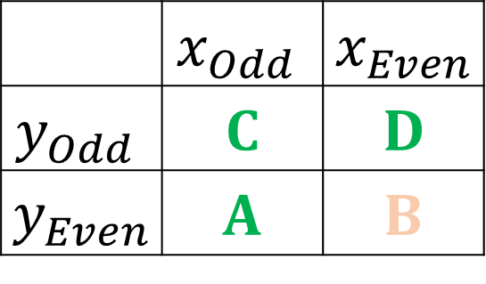
Based on whether values of $x$ and $y$ are even or odd, we can find which pocket is the ball going to fall into…
 | $$x_{Odd}$$ | $${ x}_{Even}$$
$$y_{Odd}$$ | C | D
$${ y}_{Even}$$ | A | B

Slide 33
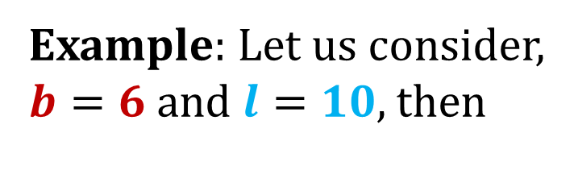
Example: Let us consider,
$b=6$ and $l=10$, then

Slide 34
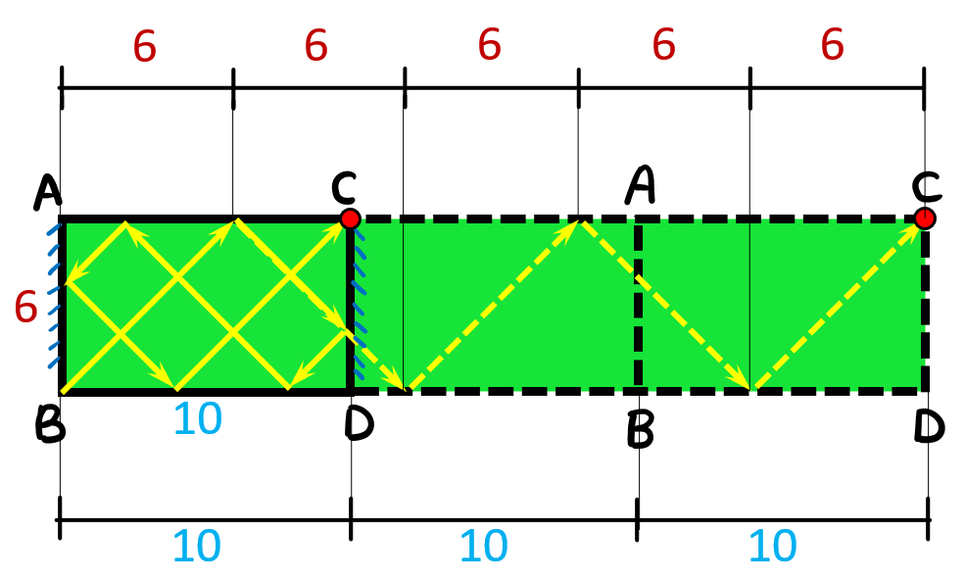
Example: Let us consider,
$b=6$ and $l=10$, then

Slide 35
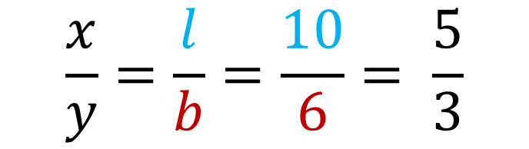
Example: Let us consider,
$b=6$ and $l=10$, then
$$\frac{x}{y}=\frac{l}{b}=\frac{10}{6}= \frac{5}{3}$$

Slide 36


Example: Let us consider,
$b=6$ and $l=10$, then
$$\frac{x}{y}=\frac{l}{b}=\frac{10}{6}= \frac{5}{3}$$
$$∴ x=5$$
$$y=3$$

Slide 37
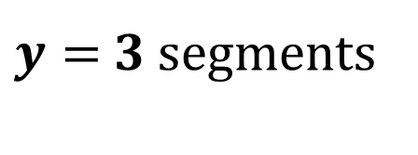
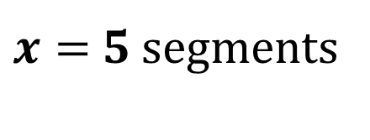
$x=$ 5 segments
Example: Let us consider,
$b=6$ and $l=10$, then
$$\frac{x}{y}=\frac{l}{b}=\frac{10}{6}= \frac{5}{3}$$
$$∴ x=5$$
$$y=3$$
$y=$3 segments

Slide 38
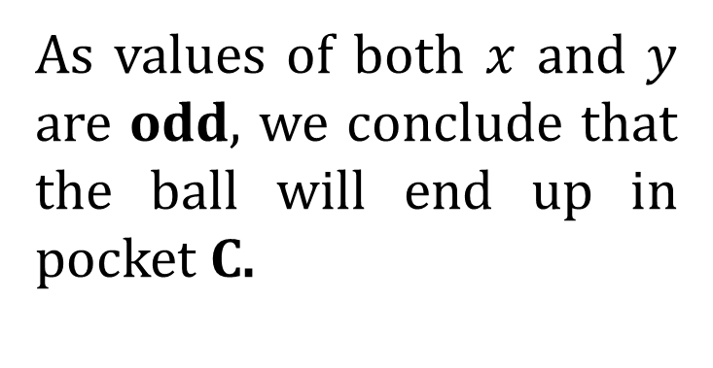
As values of both $x$ and $y$ are odd, we conclude that the ball will end up in pocket C.

Slide 39
For thinkers of BEYOND!!!

Slide 40
For thinkers of BEYOND!!!
Will the ball always end up in some pocket for any given l and b?

Slide 41
For thinkers of BEYOND!!!
Will the ball always end up in some pocket for any given l and b?
Is there any pocket in which the ball can never fall?

Slide 42
For thinkers of BEYOND!!!
Will the ball always end up in some pocket for any given l and b?
Is there any pocket in which the ball can never fall?
Let me know in the comments :)

Slide 43
